Slide 1
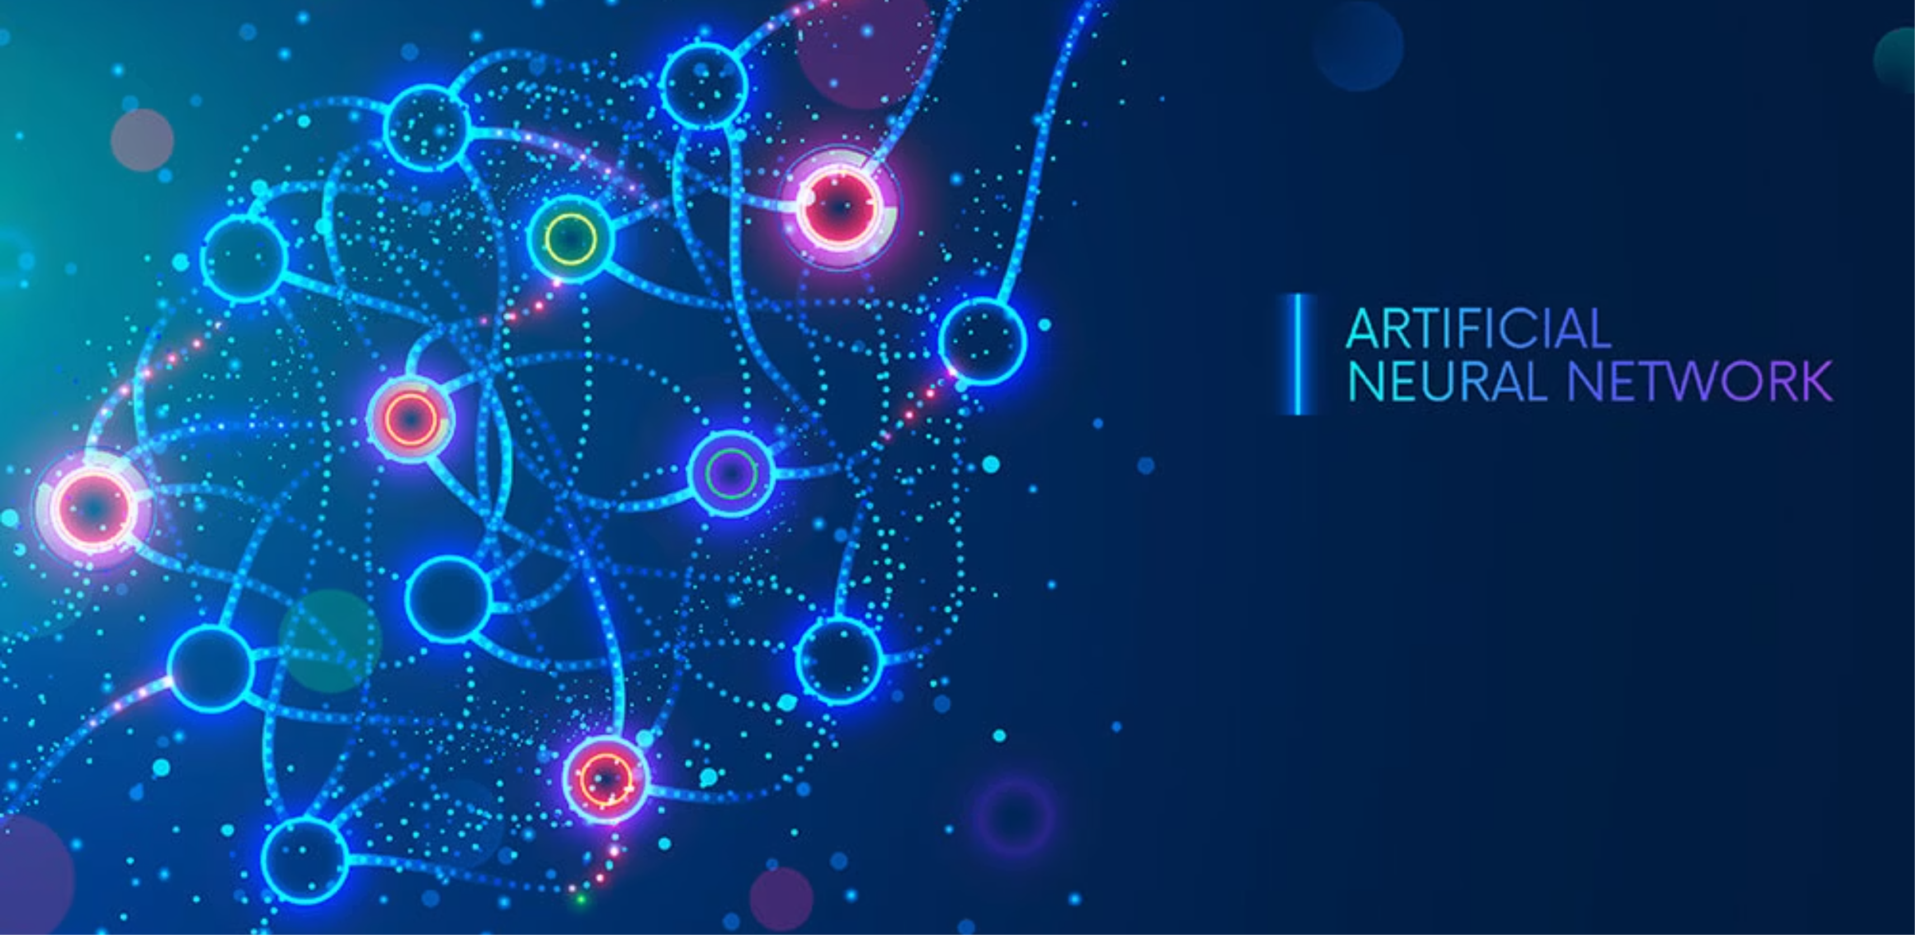
Discover how these computational models enable machines to learn, recognize patterns, and make intelligent decisions.

Slide 2
Group Members:
Hiba Mahdi
Sara AIi
Zeenah Shamil
Noor-AlHuda Ayad

Slide 3
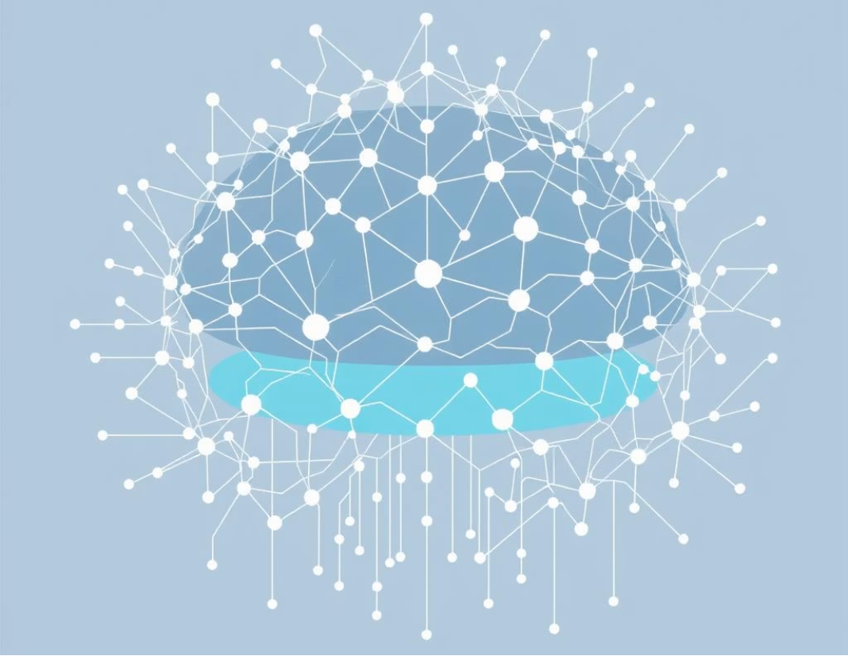
Introduction to ANN
ANN algorithms are based on the structure of the brain neural network, the big picture in neural networks is how we go from having some data, throwing it into some algorithm and hoping for the best. But what happens inside that algorithm? This question is important to answer, for many reasons; one is that you otherwise “might just regard the inner workings of a neural network as a black box”.

Slide 4
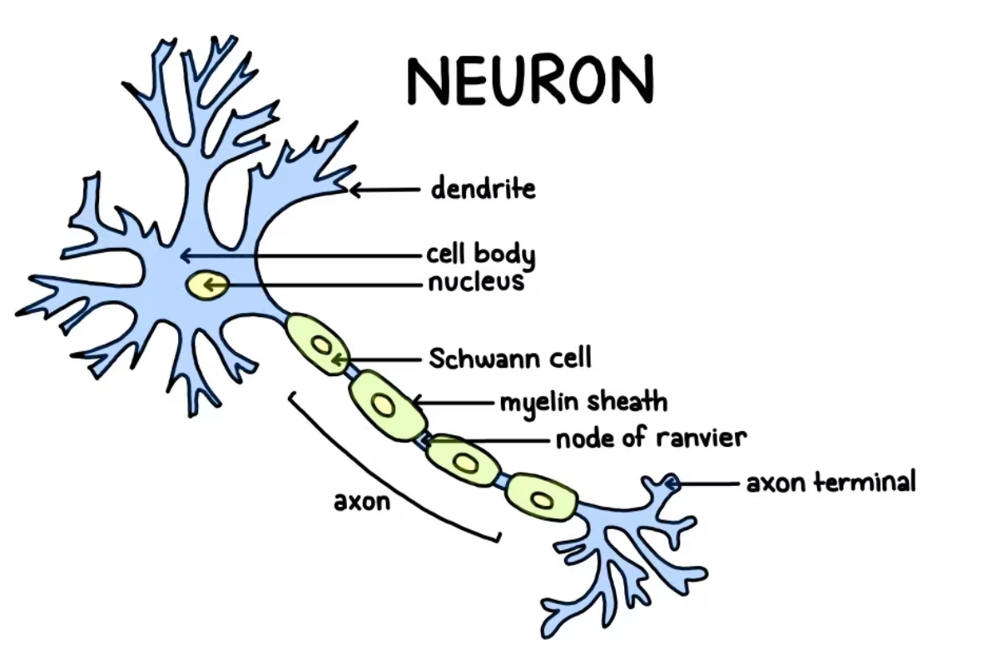
What is neural network?
A neural network is an algorithm inspired by the neurons in our brain. It is designed to recognize patterns in complex data and often performs the best when recognizing patterns in text, audio, images or video.
Such algorithms “learn” to perform tasks by considering examples, generally without being programmed with task-specific rules. For example, in image recognition task, they learn to identify images that contain cats by analyzing example images that have been manually labeled as “cat” or “no cat” and using the results “trained model” to identify cats in other images.

Slide 5
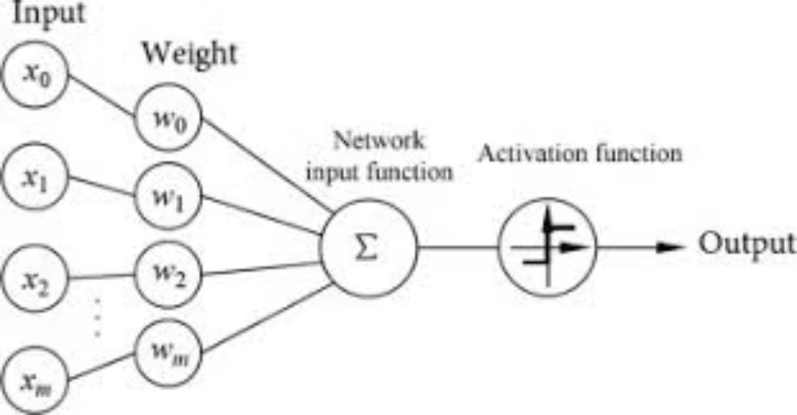
Perceptron Model
Perceptron algorithm is a simplest ANN architecture used for supervised learning of binary classifiers as single-layer neural network. They consist of four main parts including input values, weights and bias, net sum, and an activation function.
How does a Perceptron work?
The perceptron works by taking a set of input features, along with a constant 'bias' term and assigning weights to these inputs. The linear combination of the weights and inputs are taken. This linear combination is then fed through an activation function that determines which class the set of inputs belongs to.
NOTE: Weight values give the strength to the input features and will determine the influence input data has on the output product.
While bias value gives the ability to shift the activation function curve up or down.

Slide 6
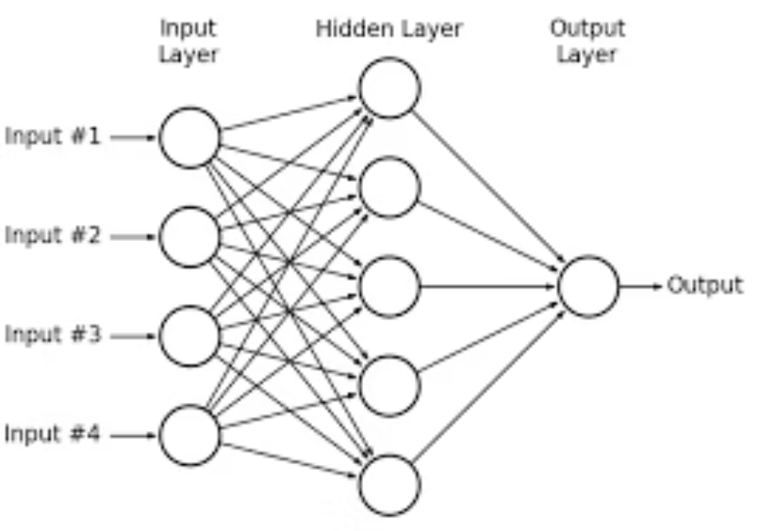
Multi-layer Perceptron
Input Layer- receives the input as data from the dataset.
Output Layer - Give the output as a prediction from the model.
Hidden Layers- Any layer between Input and Output layer.
A single perceptron won’t be enough to learn complicated systems. Thus for complicated problems, we need to expand the single perceptron, to create a multi-layer perceptron model by connecting layers of perceptrons.

Slide 7
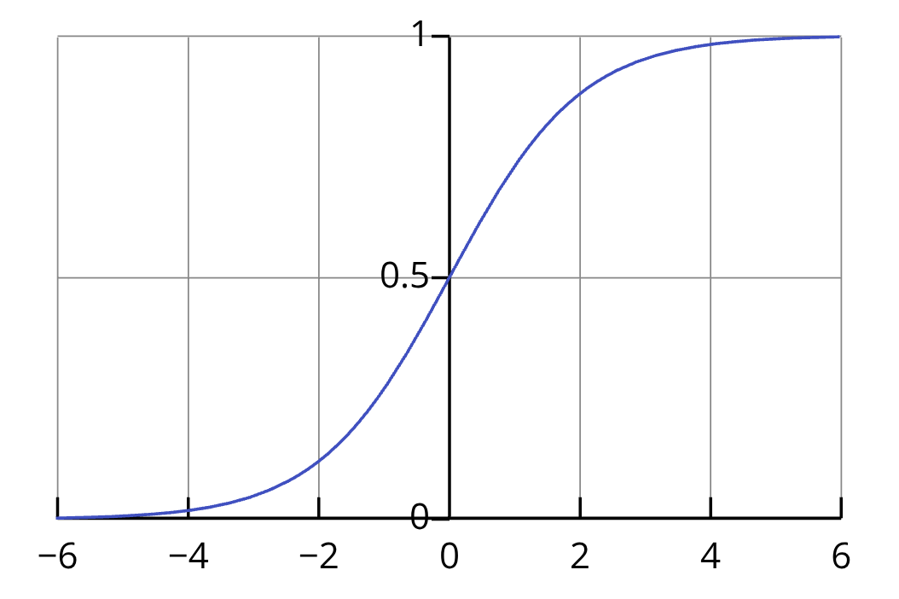
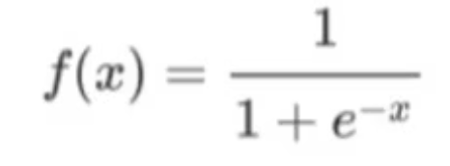
Activation Function
is a small but crucial component inside each neuron of a neural network. After the neuron adds up all its inputs, it decides what the output should be. It's a "gatekeeper" that determines whether and how strongly the neuron should "fire."
Sigmoid or Logistic Activation Function
Sigmoid functions are mathematical functions that share similar properties and they have S-shaped curves.
The main reason we use sigmoid function is because it exists between (0 to 1).
Therefore, it is especially used for models where we have to predict the probability as an output. Since probability of anything exists only between the range of 0 and 1.
It maps the feature space into probability functions.
When x is really large (goes to infinity), the output will be close to 1
When x is really small (goes to -infinity), the output will be close to 0
When x is 0, the output will be ½
It uses exponential
That means a nonlinear relationship ensures most points to be either close to 0 or 1.

Slide 8

Neurons Activation in ANN
When we say neuron, all we want to think about it is “a thing that holds a number. Specifically, a number between 0.0 and 1.0. Neural networks are really just a bunch of neurons connected together.
This number inside the neuron is called the “activation” of that neuron, and the image you might have in your mind is that each neuron is lit up when its activation is a high number.

Slide 9
The Structure of a Neural Network
Fully-connected Feedforward Network (FFN)
The Input Layer
Purpose: This is the entry point for your data. Its job is to receive the gene expression values for a single patient sample.
Structure: It consists of 100 neurons.
Why 100? Because in our feature selection step intelligently reduced the initial 7,129 genes down to the 100 most statistically significant ones. Each neuron in this input layer corresponds to one of these top 100 genes.
The Hidden Layers
Purpose: are considered as the "brain" of our network. They are responsible for finding the complex, non-linear patterns in the gene data that distinguish ALL from AML. The multi-layer structure allows the network to learn hierarchical patterns; the first layer might learn simple associations, and the subsequent layers combine those to learn more complex signatures.
Structure:
Three separate hidden layers arranged sequentially.
Each layer contains 10 neurons.
Each neuron in these layers uses the Sigmoid activation function. This function takes the neuron's calculated output and squashes it to a value between 0 and 1 before passing it to the next layer.
The Output Layer
Purpose: This is the final layer that produces the actual prediction.
Structure: It contains only one single neuron.
Why one? Because our problem is a binary classification (a yes/no question: Is this sample AML or not?).
Activation Function: This neuron also uses the Sigmoid activation function. This is a crucial choice because it forces the final output to be a number between 0 and 1.
Layer
No. of Neurons
Activation Function
Purpose
Input
100
(None)
Receives the 100 most important gene values.
Hidden Layer 1
10
Sigmoid
Learns initial patterns from the gene data.
Hidden Layer 2
10
Sigmoid
Combines patterns to learn more complex features.
Hidden Layer 3
10
Sigmoid
Further refines the learned features for prediction.
Output
1
Sigmoid
Produces the final probability of the sample being AML.

Slide 10
dropout_rate=0.3
Parameter
Fraction of neurons to drop randomly during training.
Prevents overfitting by forcing the network to generalize better. (0.3 = 30% of neurons dropped).
Layer
No. of Neurons
Activation Function
Purpose
Input
100
(None)
Receives the 100 most important gene values.
Hidden Layer 1
10
ReLU
Learns non-linear relationships between input genes and leukemia class.
Dropout
0.3
Randomly deactivates 30% of neurons from the previous layer.
Regularizes the model, reducing overfitting and improving generalization.
Hidden Layer 2
10
ReLU
Adds deeper abstraction and captures more complex feature interactions.
Dropout
0.3
Applies dropout again after second dense layer.
Provides additional regularization to avoid memorizing training data.
Hidden Layer 3
5
ReLU
Gradually reduces network size to help the model compress information before output.
Output
1
Sigmoid
Produces a probability (0–1) for binary classification (ALL vs AML).
Return
return model
Returns the compiled Keras Sequential model.
Makes the function reusable — you can call it with different input sizes or hyperparameters.

Slide 11
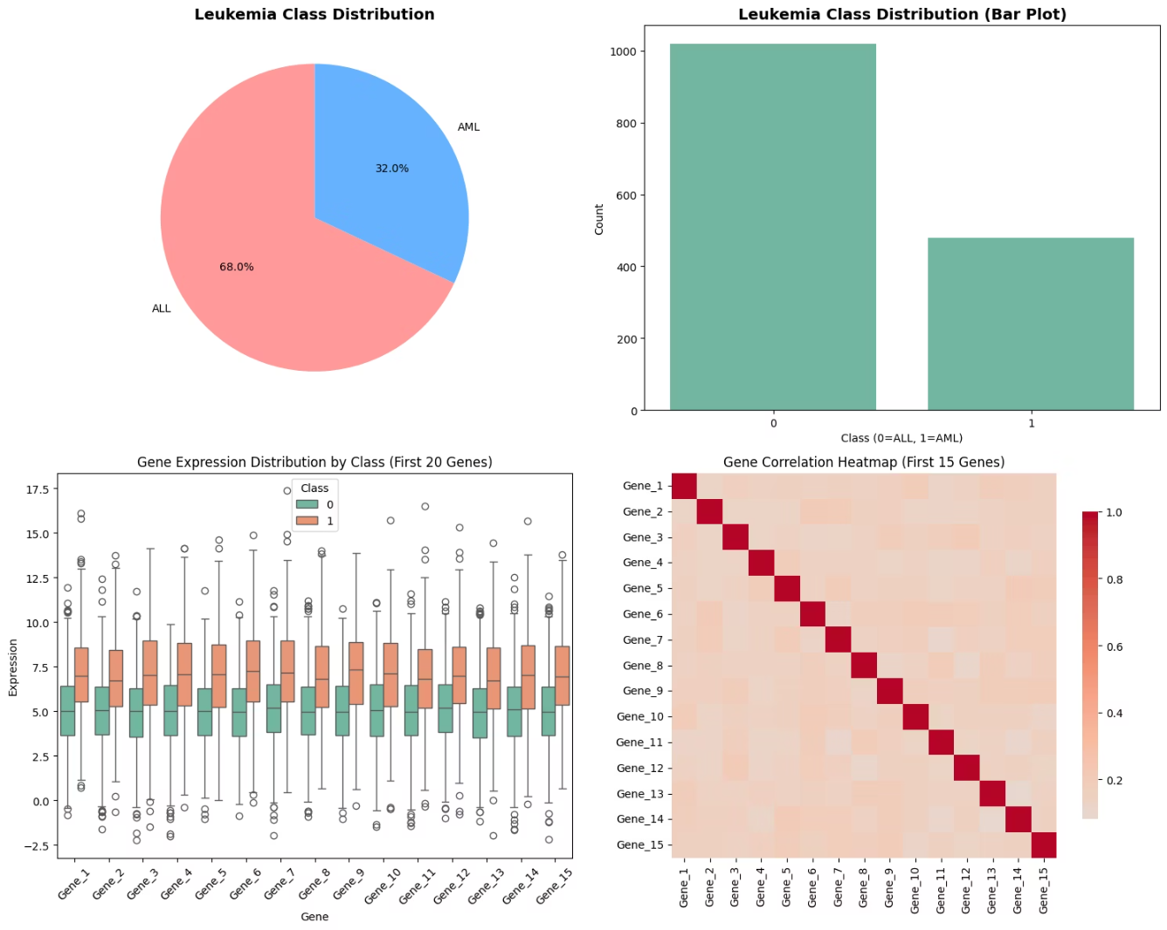
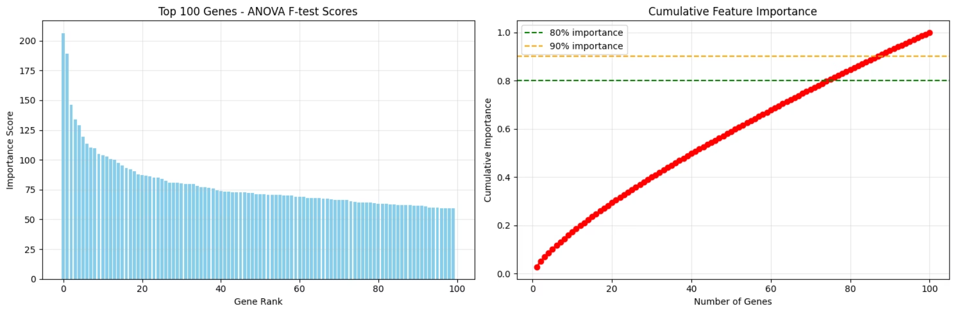
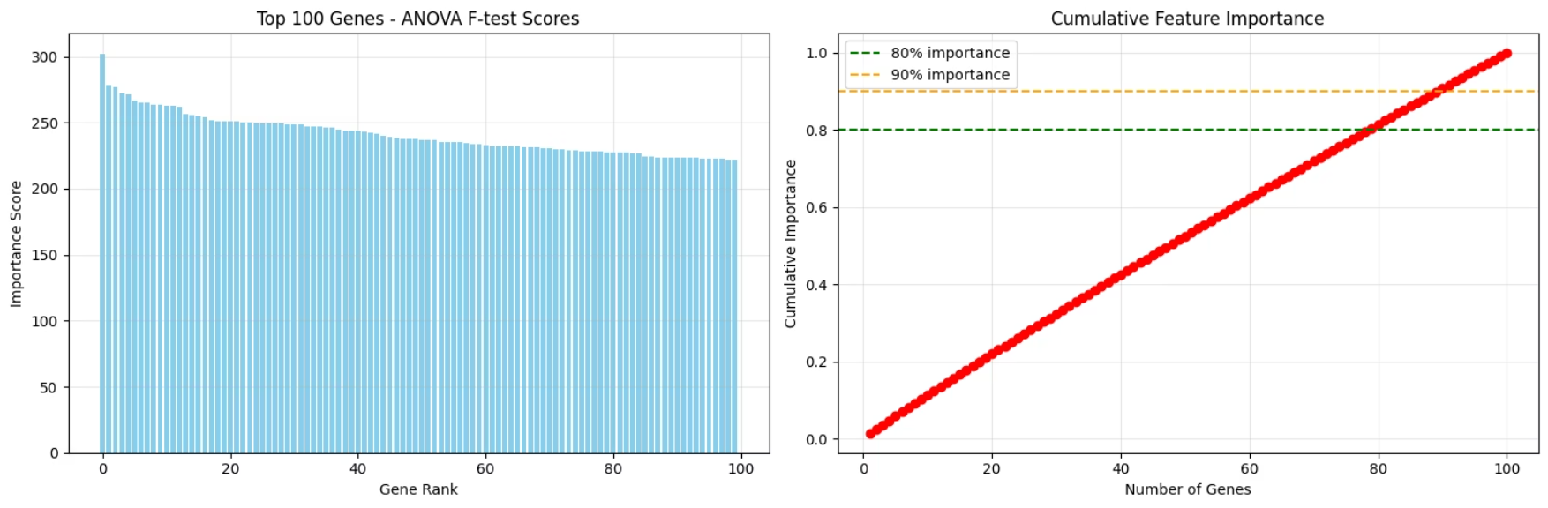
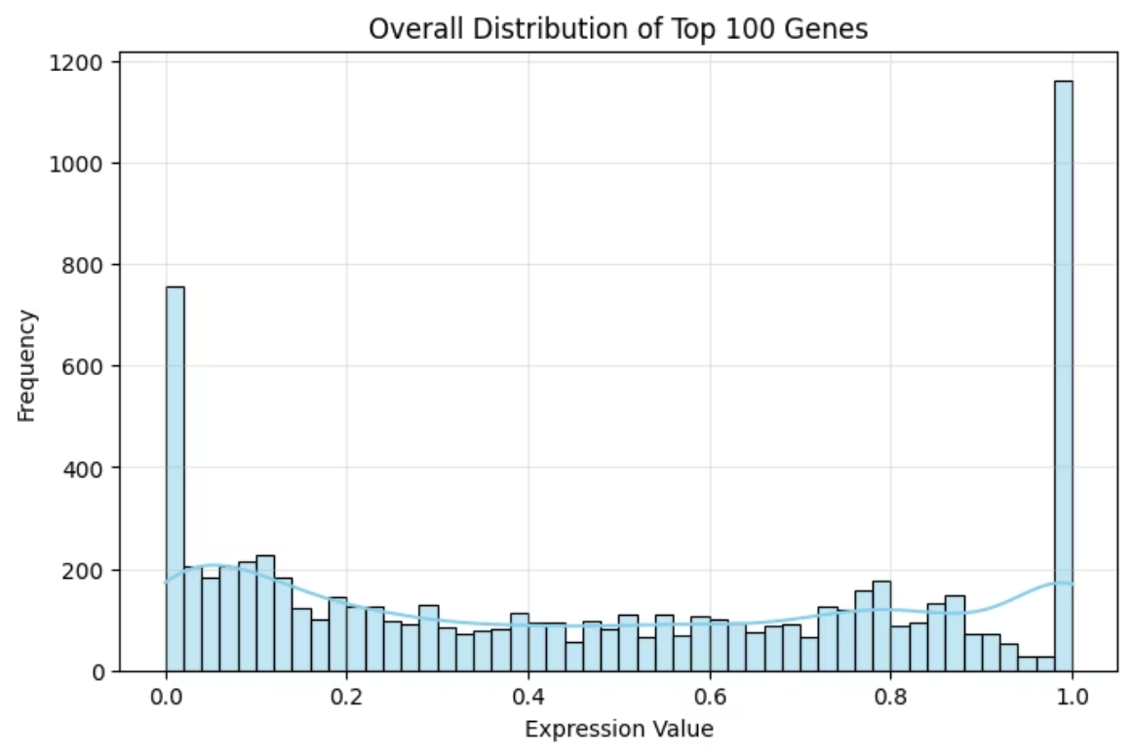
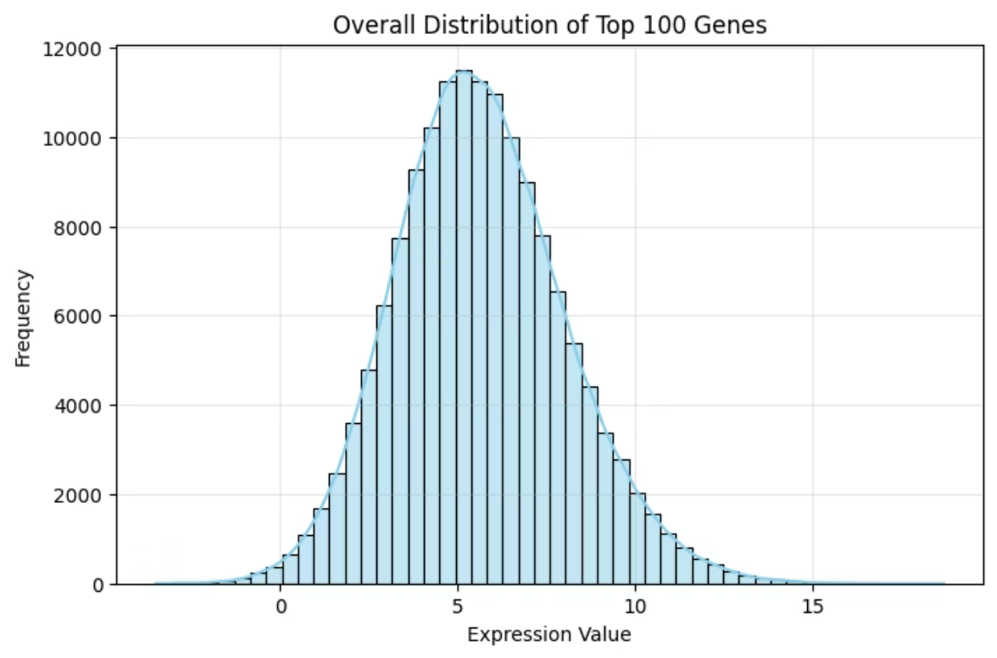
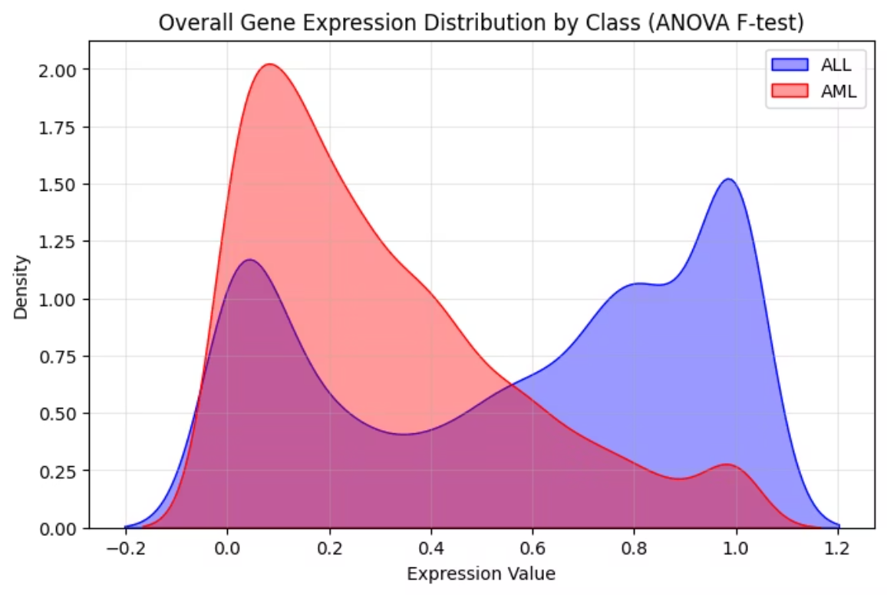

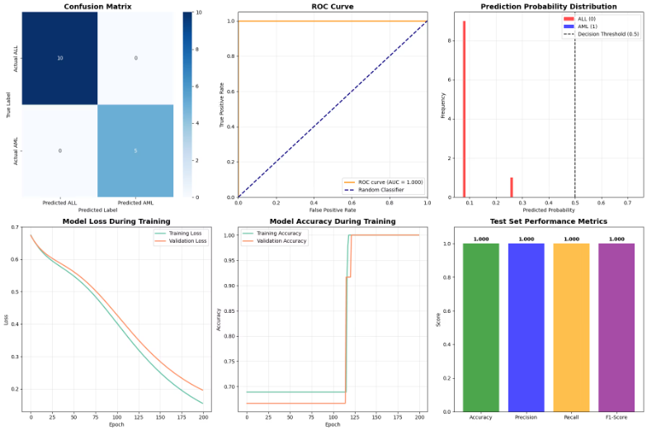
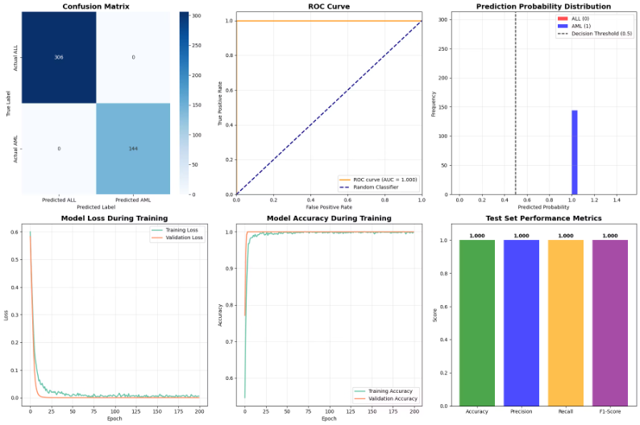
Old Database
New Database
Dataset Shape: (72, 7130)
Dataset Shape: (1500, 501)
Class distribution: Leukemia_class
0 (ALL) 49
1 (AML) 23
Class distribution: Leukemia_class
0 (ALL) 1020
1 (AML) 480

Slide 12
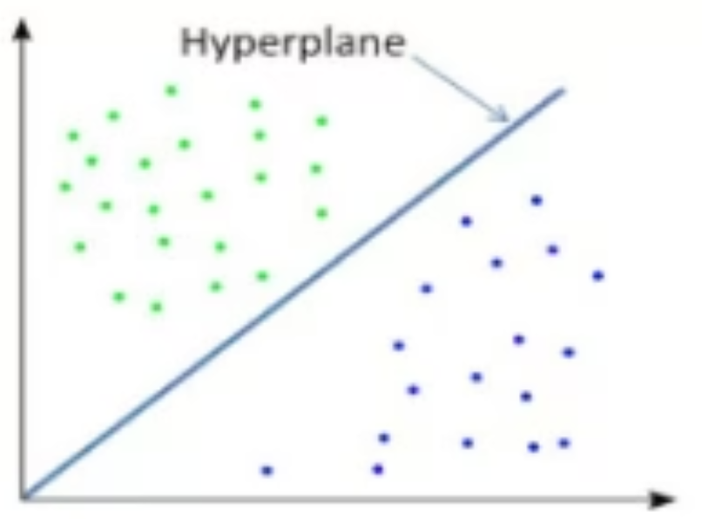
Choosing the Hidden Layers
How to choose the number of hidden layer and their nodes?
If the data is linearly separable, then you don't need any hidden layers because the output layer already calculates a linear combination of features and outputs a number that has discriminative power.
If the data is less complex and is having fewer dimensions or features then neural networks with 1 to 2 hidden layers would work.
If the data is complex and having large dimensions or features then to get an optimum solution, 3 to 5 hidden layers can be used.
Note: It should be kept in mind that increasing hidden layers would also increase the complexity of the model and choosing hidden layers such as 8, 9, or more may sometimes lead to over-fitting (good performance on the training data, poor generalization to other data “validating or testing”).
How to choose the number of hidden nodes
The number of hidden neurons should be between the size of the input layer and the output layer.
The most appropriate number of hidden neurons is sqrt (input layer nodes * output layer nodes)

Slide 13


Weighted Sum
Hidden Layers
Compute weighted inputs per neuron
Propagate activations through network
Input Layer
Activation Function
Output Layer
Receive raw features and signals
Apply nonlinearity to produce output
Generate final predictions or decisions

Slide 14
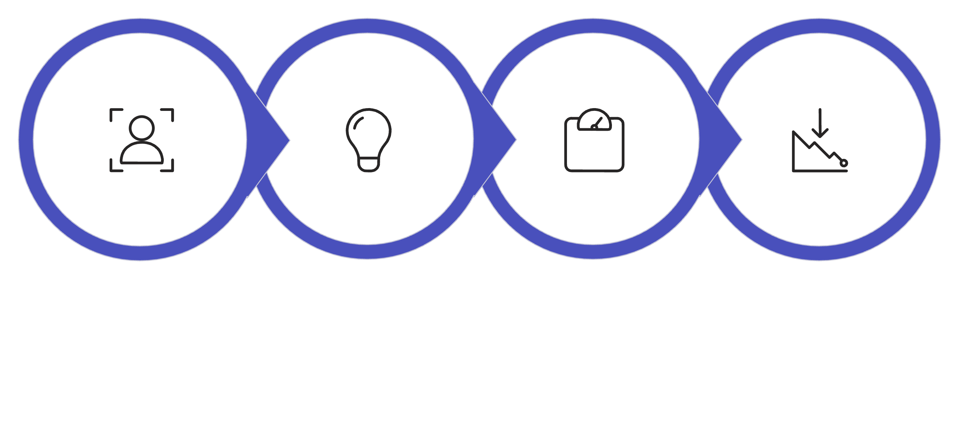
How Does the Network Learn? (Training)
The Goal of Training: To find the perfect set of "weights" for all the connections so that the network's predictions are as accurate as possible.
The Process:
Provide Examples: We show the network thousands of examples from the training data (e.g., a patient's gene data and their correct diagnosis).
Make a Prediction: The network makes a guess, or a prediction.
Calculate the Error (Loss): We compare the network's guess to the correct answer and measure how wrong it was. This is called the "loss."
Adjust and Repeat: The network then works backward (a process called backpropagation) to slightly adjust all of its weights to reduce the error.
Provide Examples
Make a Prediction
Calculate Loss
Adjust (Backprop)
This process is repeated thousands of times, and with each cycle, the network gets better and better at its task.

Slide 15
Training Strategy:
Optimizer: We used the Adam optimizer, an efficient and popular algorithm for adjusting the network's weights during training.
Loss Function: We used Binary Cross-Entropy, the standard mathematical formula for measuring error in a two-class classification problem.
Smart Training: We used Early Stopping. This technique monitors the model's performance and stops the training process automatically when it's no longer improving, which prevents the model from "memorizing" the training data (overfitting).
Why Was an ANN the Right Tool for This Project?
Handles Complexity: Gene expression data isn't simple. The way genes interact is highly complex and non-linear. ANNs are specifically designed to learn these kinds of intricate relationships that simpler models might miss.
Automatic Feature Learning: The hidden layers automatically learn the most relevant "features" or combinations of genes. We don't need to tell the model to look for "high CD33 and low Zyxin"; it discovers these predictive patterns on its own.
Proven Power: Deep learning has become the state-of-the-art in many areas of bioinformatics and medical image analysis for its ability to extract meaningful signals from high-dimensional data.

Slide 17

Thank You!
For your attention and engagement during our presentation.
We hope you gained valuable insights into the fascinating world of ANNs and their potential in medical diagnostics.

